Slide 1
Lecture 8 Evolutionary Learning and
Genetic Algorithm
CS582
Machine Learning: Getting Computers
to Program Themselves
“Discovering the Learning Dynamics of the Laws of Nature”
Dr. Emdad Khan
ekhan@mum.edu
Dept. of Computer Science
Maharishi University of Management
May, 2018

Slide 2
Evolutionary Learning
Remember conventional search could not solve many problems in a satisfactory way (last lecture).
Our goal here is to learn as much as we can from Evolution (the same way we came up with Neural Nets by using ideas from Neuroscience)
And see whether we can solve complex search problems which are intractable.

Slide 3
Evolutionary Learning
As we know, learning from the nature as much as we can is always very useful and efficient – the main reason is that we are part of the nature!
We will view evolution as a search – usually we do not think this way – but this type of thinking can help us solve some complex search / discrete optimization problems.

Slide 4
Evolutionary Learning & GA
Evolution works on a population through an imaginary fitness landscape.
This has an implicit bias towards animals that are ‘fitter', i.e., those animals that live long enough to reproduce, are more attractive, and so get more mates, and generate more and healthier offspring (read Darwin’s Theory of Evolution for details)
The genetic algorithm (GA) models the genetic process that gives rise to evolution.

Slide 5
Evolutionary Learning & GA
GA is often, very effective, it has an array of parameters that are crucial, but hard to set.
It has become a very popular algorithm for people to use when they have no idea of any other way to find a reasonable solution.
We will show some good results on some complex problems using GA.

Slide 6
Genetic Process in Evolution
In biological organisms, both parents give some genetic information to their offspring.
Each parent passes on one chromosome out of their two (Fig. 10.1 next slide).
Hence, children have similarities with their parents, and there is lots of genetic inheritance.
However, there are also random mutations, caused by copying errors when the chromosome material is reproduced.
Real genetics is obviously a lot more complicated than this, but we are taking only the things that we want for our model.

Slide 7
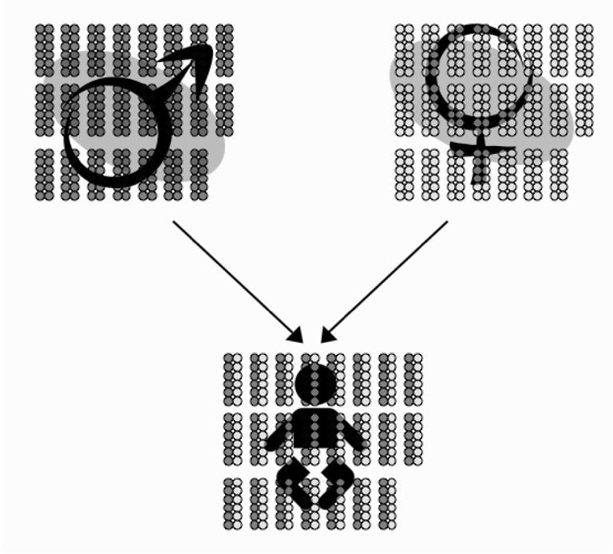
Genetic Process in Evolution
FIGURE 10.1 Each adult in the mating pair passes one of their two chromosomes to their offspring.

Slide 8
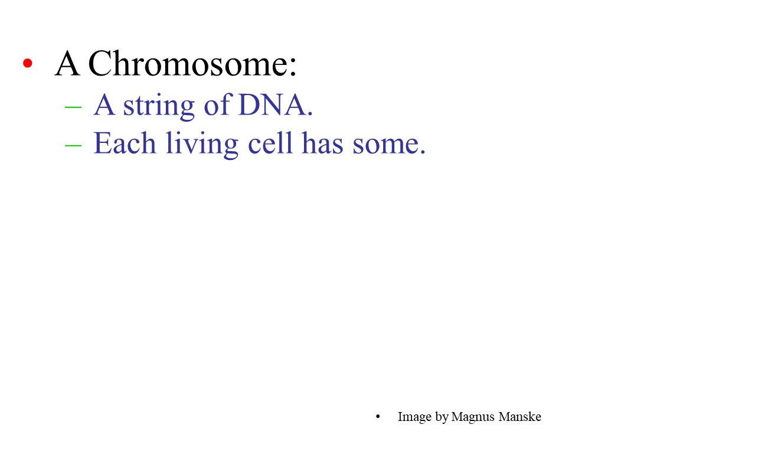
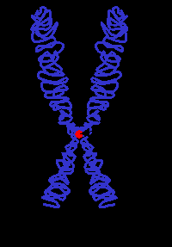
Evolution in the nature - 1

Slide 9
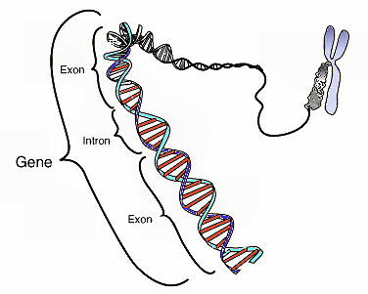
Evolution in the nature - 2
Each chromosome
contains a set of genes.
A gene is a block of DNA.
Each gene determines
some aspect of the
organism
(e.g., eye colour).

Slide 10
Genetic Algorithm (High Level)
Basic Steps
A method for representing problems as chromosomes.
A way to calculate the fitness of a solution.
A selection method to choose parents.
A way to generate offspring by breeding the parents.
Stop when stopping criteria is met.

Slide 11
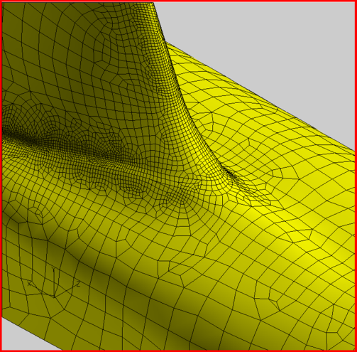
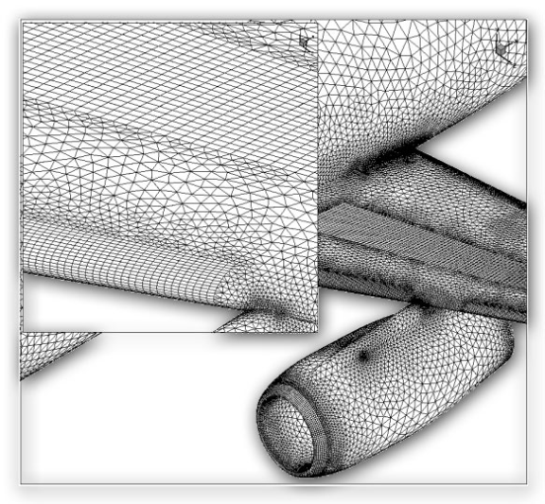
Motivation
Searching some search spaces with traditional search methods would be intractable (as we have already shown)
  Example: Designing the surface of an aircraft.
Image source: http://www.centaursoft.com/cms/index.php?section=25
Notes:
Images from http://www.centaursoft.com/cms/index.php?section=25

Slide 12
Applicable situations
Often used for optimization (scheduling, design, etc.) problems, though can be used for many other things as well, as we’ll see a bit later.
  Good problem for GA: Scheduling air traffic
  Bad problems for GA: Finding large primes (why?), 2D pathfinding (why?)
Notes:
Finding large primes is a bad problem for GA because the fitness landscape is not continuous – hard to differentiate between something 1 bit away from a prime, and something that is the complement of a prime.
2D pathfinding bad because the search space is small, so better off with A*.

Slide 13
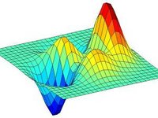
Applicable situations
Genetic algorithms work best when the “fitness landscape” is continuous (in some dimensions). This is also true of standard search, e.g. A*.
  Intuitively, this just means that we can find a heuristic that gives a rough idea of how close a candidate is to being a solution.
Image source: scholarpedia.org

Slide 14
Genetic algorithm from Search Standpoint
Genetic algorithms are a randomized heuristic search strategy.
Basic idea: Simulate natural selection, where the population is composed of candidate solutions.
Focus is on evolving a population from which strong and diverse candidates can emerge via mutation and crossover (mating).

Slide 15
Basic algorithm (again)
Create an initial population (can be random)
While the best candidate so far is not a solution:
  Create new population using successor functions.
  Evaluate the fitness of each candidate in the population.
Return the best candidate found.

Slide 16
Simple example – alternating string
Let’s try to evolve a length 4 alternating string
Initial population: C1=1000, C2=0011
We roll the dice and end up creating C1’ = cross (C1, C2) = 1011 and C2’ = cross (C1, C1) = 1000.
We mutate C1’ and the fourth bit flips, giving 1010. We mutate C2’ and get 1000.
We run our solution test on each. C1’ is a solution (alternating string), so we return it and are done.

Slide 17

Another Example
Fitness function: number of non-attacking pairs of queens (min = 0, max = 8 × 7/2 = 28)
24/(24+23+20+11) = 31%
23/(24+23+20+11) = 29% etc

Slide 18
Basic components
Candidate representation
  Important to choose this well. More work here means less work on the successor functions.
Successor function(s)
  Mutation, crossover
Fitness function
Solution test
Some parameters
  Population size
  Generation limit

Slide 19
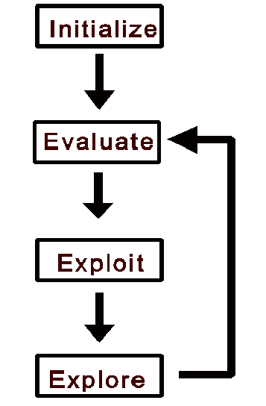
© http://www.spectroscopynow.com
all individuals in population
evaluated by fitness function
individuals allowed to
reproduce (selection),
crossover, mutate
Flowchart of GA
Notes:
Flowchart of GA iteration

Slide 20
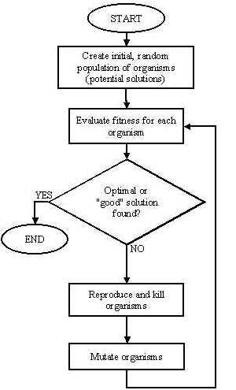
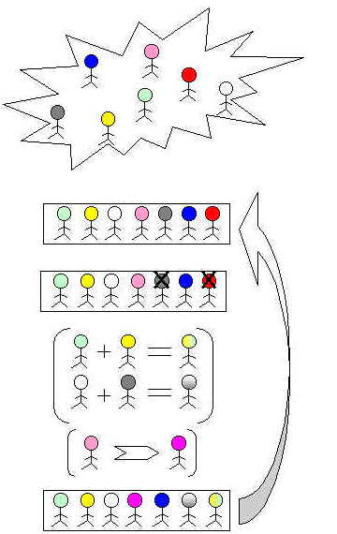
http://ib-poland.virtualave.net/ee/genetic1/3geneticalgorithms.htm

Slide 21
One More Example
Problem:
“Find” the binary number 11010010.

Slide 22
Initialization
We start with 5 random binary numbers with 8 digits each.
01001010
10011011
01100001
10100110
01010011

Slide 23
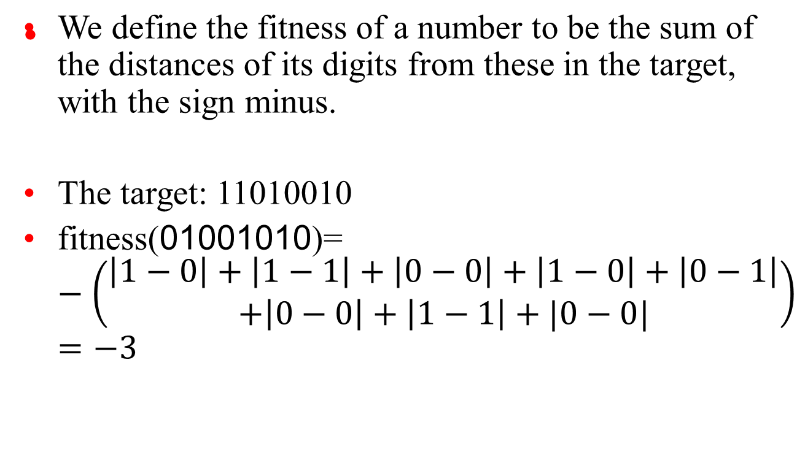
The fitness function

Slide 24
The target: 11010010
fitness(01001010)=-3
fitness(10011011)=-3
fitness(01100001)=-5
fitness(10100110)=-4
fitness(01010011)=-2

Slide 25
Parent Selection
In each generation, some constant number of parents, say, 4 are chosen. Higher is the fitness, greater is the probability of choosing the individual.

Slide 26
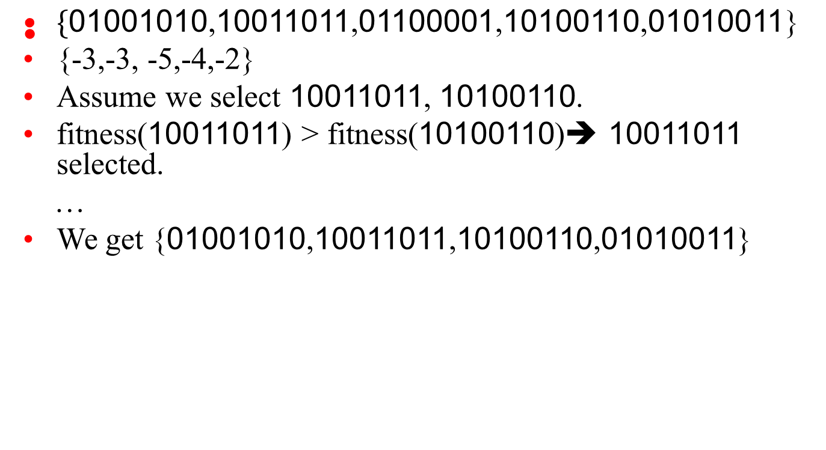

Slide 27
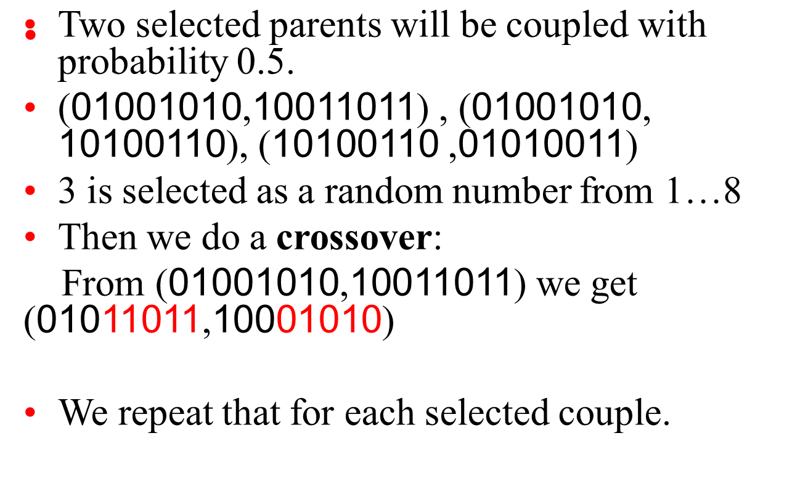
Recombination

Slide 28
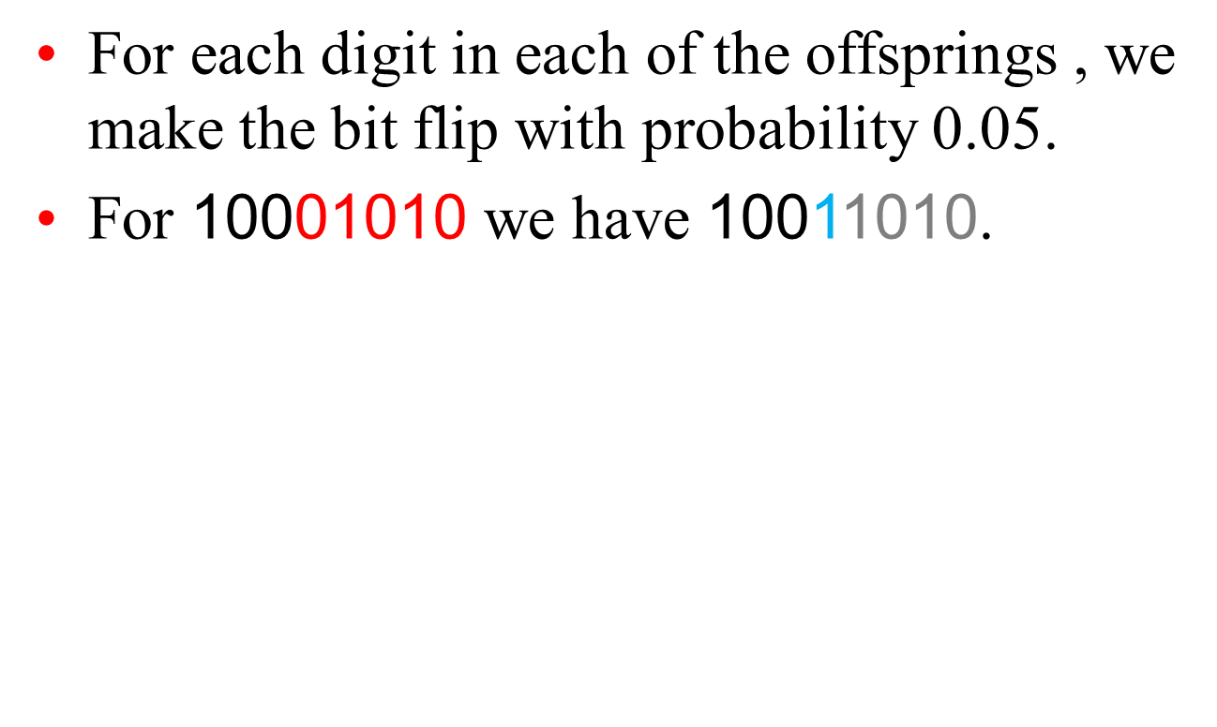
Mutation

Slide 29
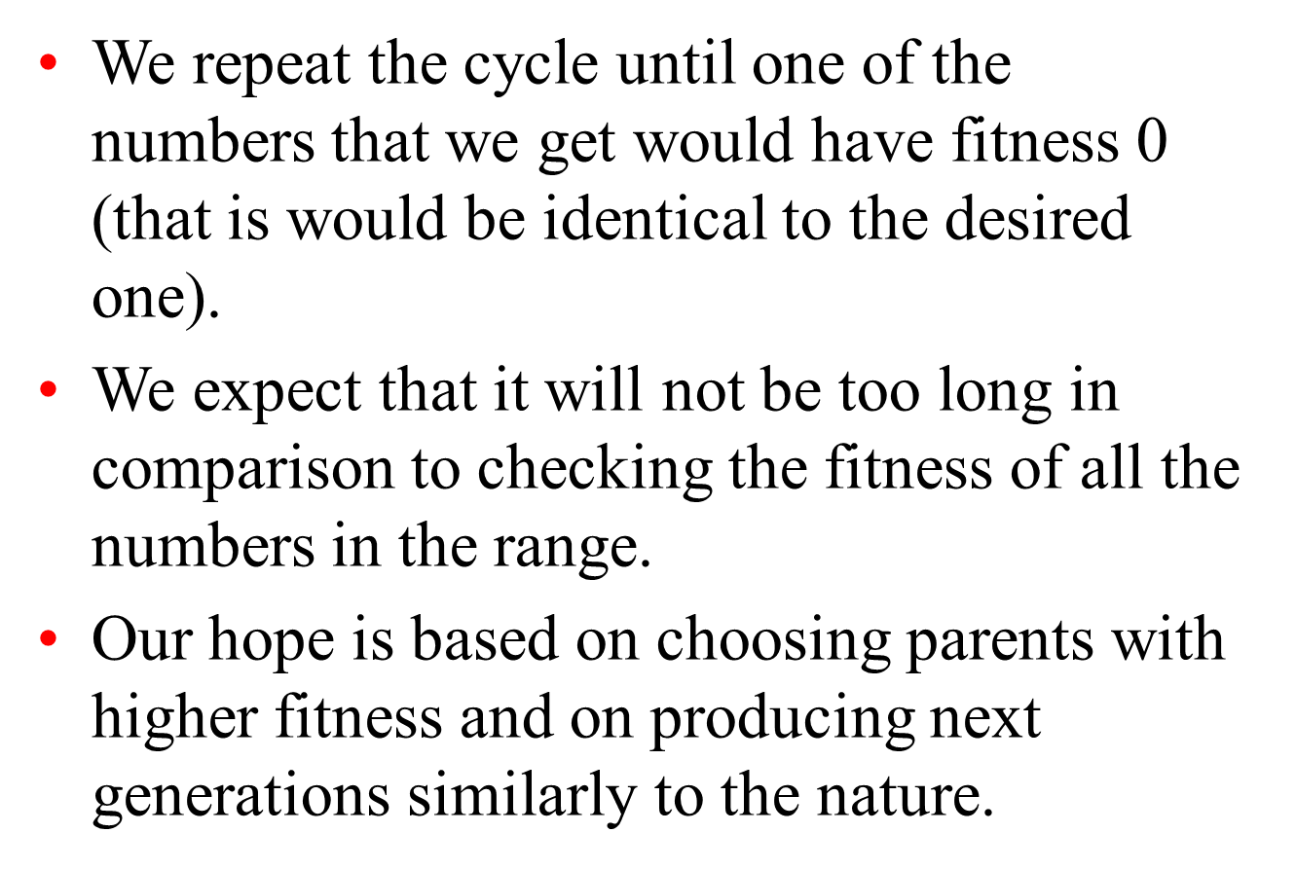
The process and it’s termination

Slide 30
Basic Genetic Algorithm - 1
Initialization – generate N random strings of length L with the chosen alphabet
Learning – repeat:
* create an (initially empty) new population
* repeat:
· select two strings from current
population, preferably using fitness-
proportional selection

Slide 31
Basic Genetic Algorithm -2
· recombine them in pairs to produce two new strings
· mutate the offspring
· either add the two offspring to the population, or use tournaments to put two strings from the four of parents and offspring into the population
until N strings for the new population are generated

Slide 32
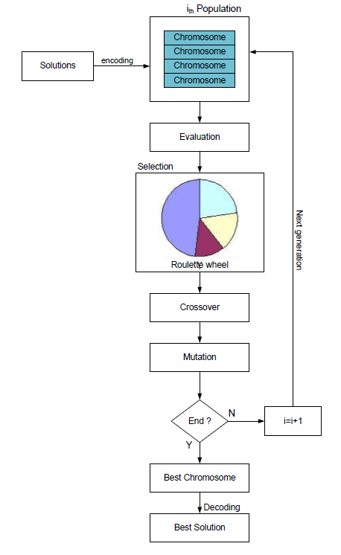
Basic Genetic Algorithm – More detailed Flowchart

Slide 33
Candidate representation
We want to encode candidates in a way that makes mutation and crossover easy.
The typical candidate representation is a binary string. This string can be thought of as the genetic code of a candidate – thus the term “genetic algorithm”!
  Other representations are possible, but they make crossover and mutation harder.

Slide 34
Candidate representation example
Let’s say we want to represent a rule for classifying bikes as mountain bikes or hybrid, based on these attributes*:
  Make (Bridgestone, Cannondale, Nishiki, or Gary Fisher)
  Tire type (knobby, treads)
  Handlebar type (straight, curved)
  Water bottle holder (Boolean)
We can encode a rule as a binary string, where each bit represents whether a value is accepted.
Make Tires Handlebars Water bottle
B
C
N
G
K
T
S
C
Y
N
*Bikes scheme used with permission from Mark Maloof.

Slide 35
Candidate representation example
The candidate will be a bit string of length 10, because we have 10 possible attribute values.
Let’s say we want a rule that will match any bike that is made by Bridgestone or Cannondale, has treaded tires, and has straight handlebars. This rule could be represented as 1100011011:
Make Tires Handlebars Water bottle
1
1
0
0
0
1
1
0
1
1
B
C
N
G
K
T
S
C
Y
N

Slide 36
Successor functions
Mutation – Given a candidate, return a slightly different candidate.
Crossover – Given two candidates, produce one that has elements of each.
We don’t always generate a successor for each candidate. Rather, we generate a successor population based on the candidates in the current population, weighted by fitness.

Slide 37
Fitness function
The fitness function is analogous to a heuristic that estimates how close a candidate is to being a solution.
In general, the fitness function should be consistent for better performance. However, even if it is, there are no guarantees. This is a probabilistic algorithm!
In our classification rule example, one possible fitness function would be information gain over training data.

Slide 38
Solution test
Given a candidate, return whether the candidate is a solution.
Often just answers the question “does the candidate satisfy some set of constraints?”
Optional! Sometimes you just want to do the best you can in a given number of generations, e.g. the classification rule example.

Slide 39
Basic algorithm (recap)
Create an initial population, either random or “blank”.
While the best candidate so far is not a solution:
  Create new population using successor functions.
  Evaluate the fitness of each candidate in the population.
Return the best candidate found.

Slide 40
Pros and Cons
Pros
  Faster (and lower memory requirements) than searching a very large search space.
  Easy, in that if your candidate representation and fitness function are correct, a solution can be found without any explicit analytical work.
Cons
  Randomized – not optimal or even complete.
  Can get stuck on local maxima, though crossover can help mitigate this.
  It can be hard to work out how best to represent a candidate as a bit string (or otherwise).

Slide 41
Application – Map Coloring
Graph coloring is a typical discrete optimization problem.
We want to color a graph using only k colors, and choose them in such a way that adjacent regions have different colors.
It has been mathematically proven that any two-dimensional planar graph can be colored with four colors.
Even though it might be impossible, we are going to try to solve the three-color problem using a genetic algorithm.

Slide 42
Application – Map Coloring
(Quick Review) With all problems using a GA, there are three basic tasks that need to be performed:
  Encode possible solutions as strings
  Choose a suitable fitness function
  Choose suitable genetic operators
  Method to choose parents & a way to generate offspring by breeding the parents using genetic operators.
  Stop when stopping criteria is met.

Slide 43
Encoding
We'll choose our alphabet to consist of the three possible shades (black (b), dark (d), and light (l)).
So for a six-region map, a possible string is α = {bdblbb}. This says that the first region is black, the second dark grey, etc. (Figs. – next 2 slides).

Slide 44
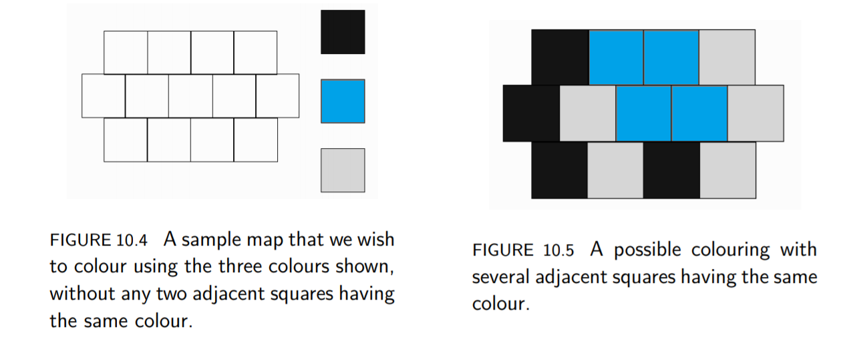
Encoding
  FIGURE 10.4 A sample map that we wish to color using the three colors shown, without any two adjacent squares having the same color.

Slide 45
Fitness Function
we want to minimize (a cost function) is the number of times that two adjacent regions have the same color.
Just count the number of correct edges that says the boundaries are correct.
The example in Figure 10.5 has 16 out of the 26 boundaries correct (where a boundary is the intersection between any two squares), so its fitness is 16.

Slide 46

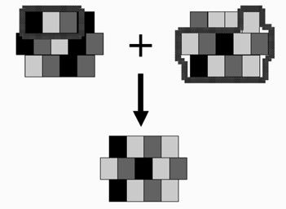
Mutation & Crossover
  Using standard Operators

Slide 47
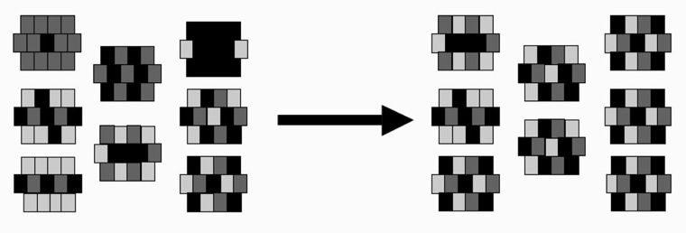
After One Generation
  FIGURE 10.8 One generation of the GA working on the map coloring problem. GA Produced a good solution.

Slide 48
Application – Knapsack -1
Figure 10.10 (next slide) shows a graph of the output when the GA is run on this problem for 100 iterations.
The GA rapidly finds a near-optimal solution (of 499.94) to this relatively simple problem, although in this run it did not find the global optimum of 499.98.

Slide 49
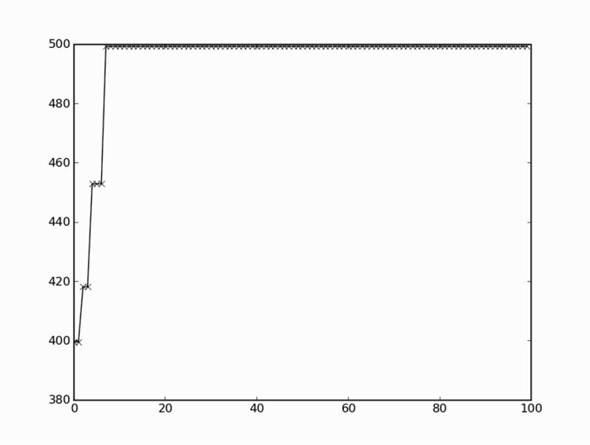
Application – Knapsack - 2
GA found very close to Global Optima in a few iterations.

